Slide 1
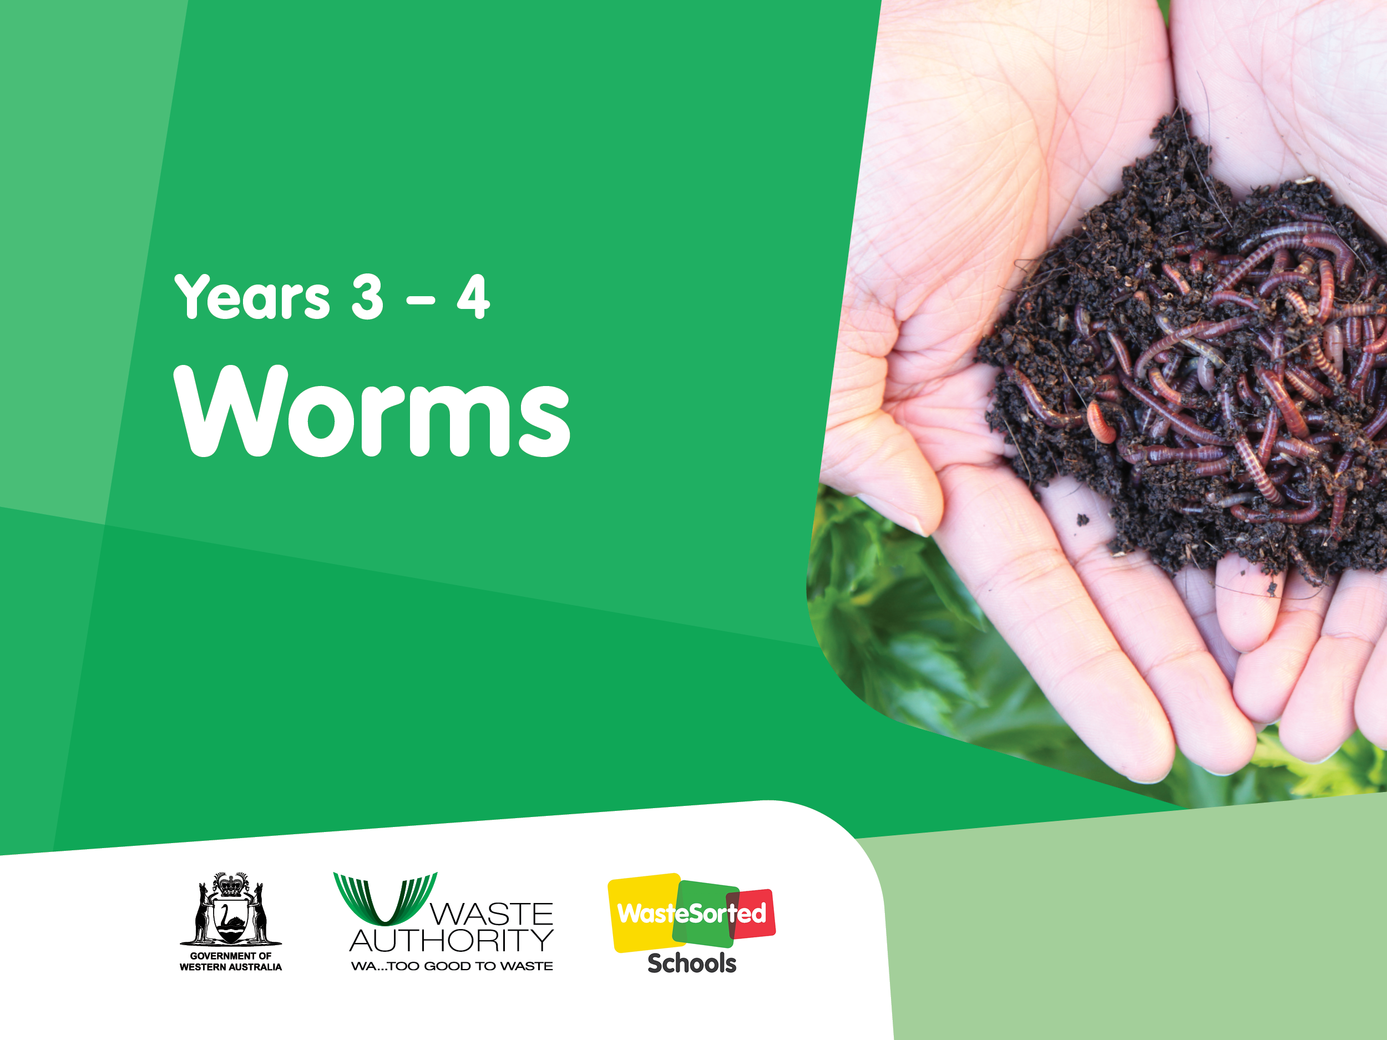

Slide 2
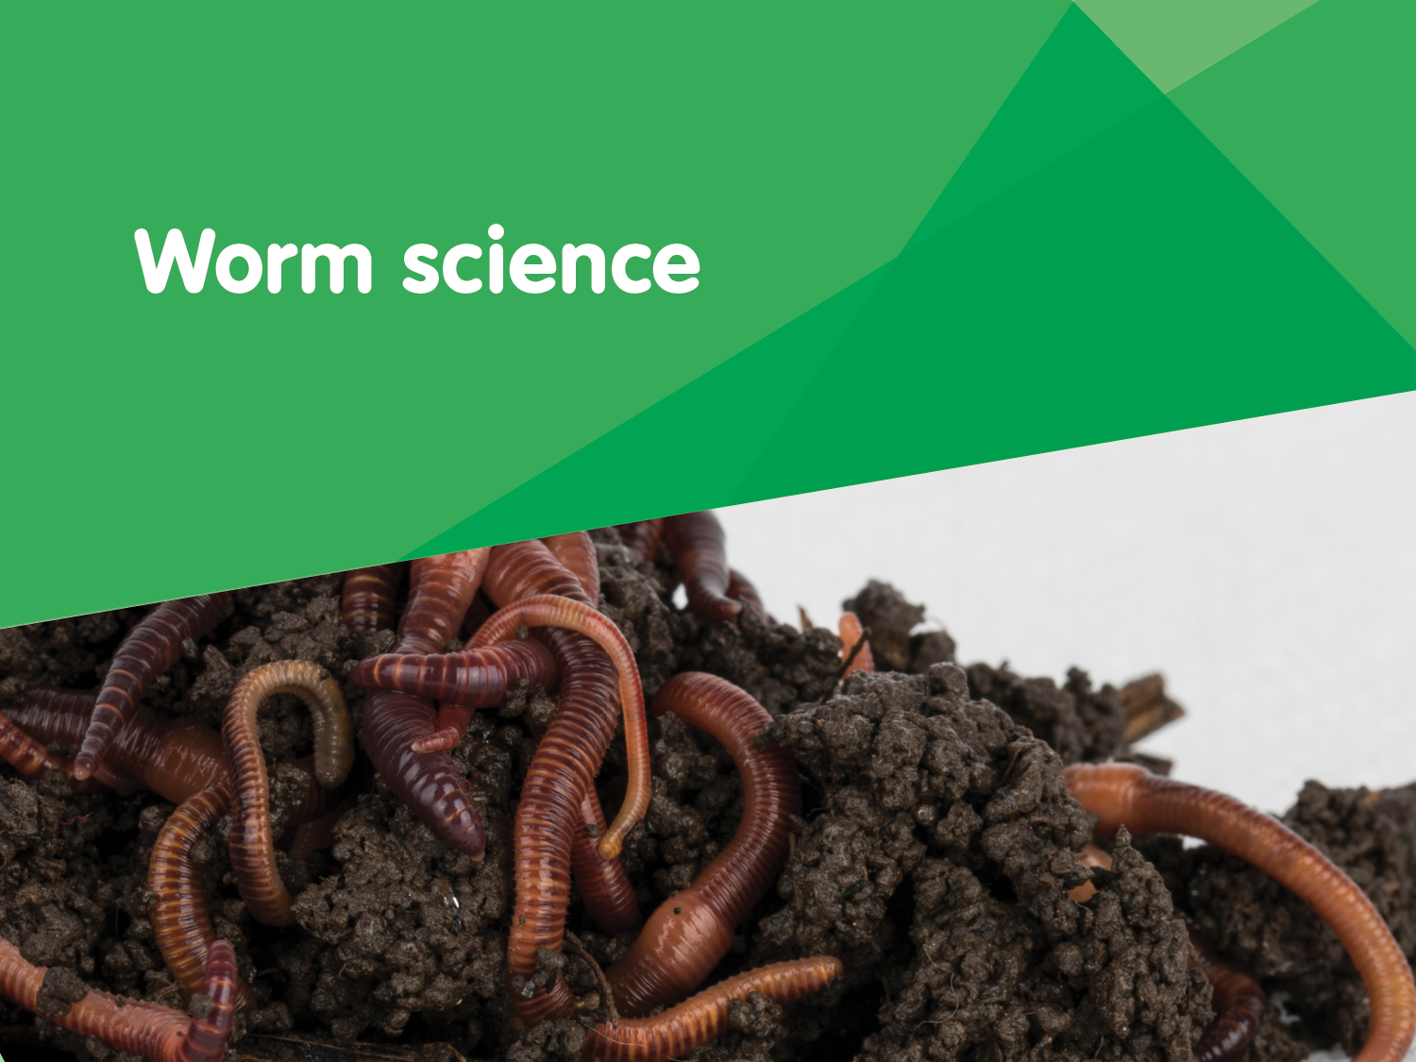

Slide 3
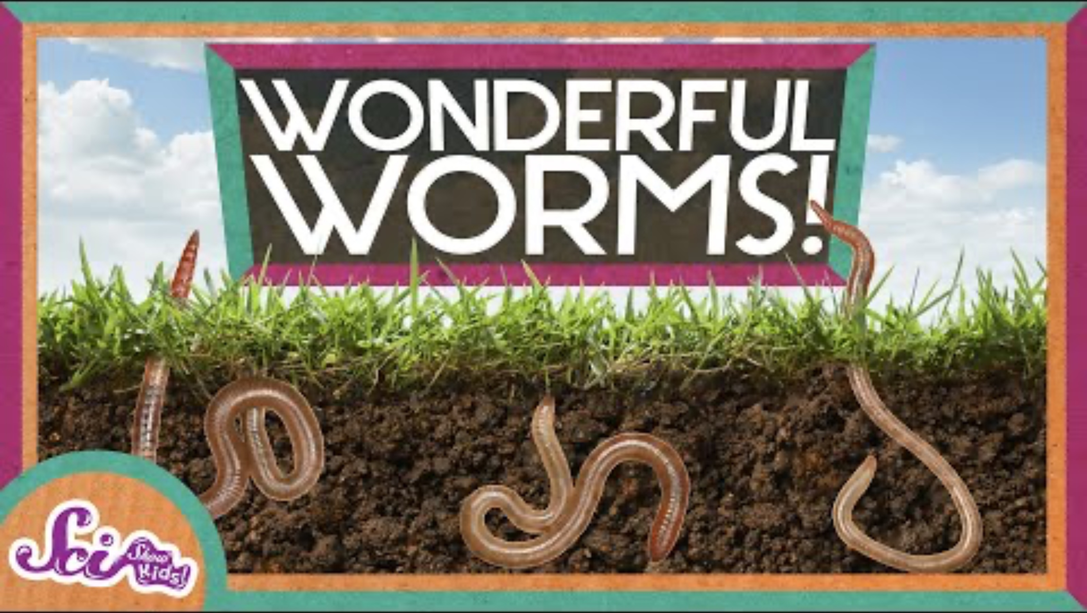
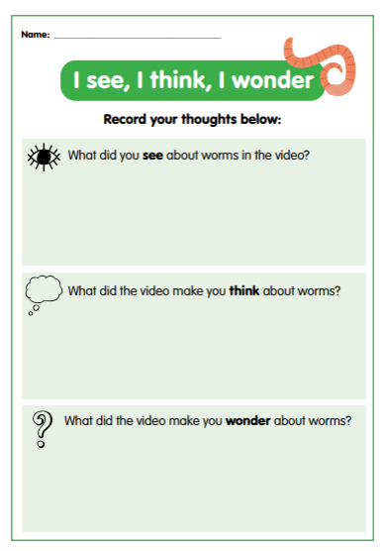
Looking at worms
Discussion questions
How do worms move?
How do worms breathe?
What do worms eat?
How much can a worm eat in a day?
How do worms help improve the soil?
Let’s watch the video to learn some interesting facts about worms
Worms Are Wonderful | Amazing Animals | Backyard Science | SciShow Kids - YouTube
While watching the video, keep in mind things you could add to your I see, I think, I wonder worksheet.

Slide 4
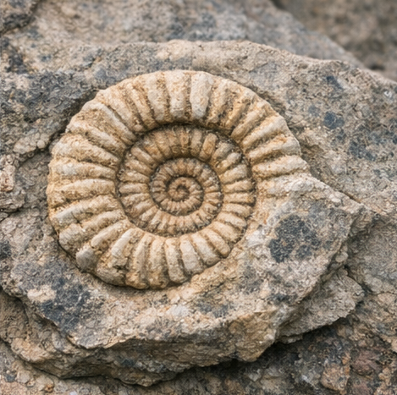
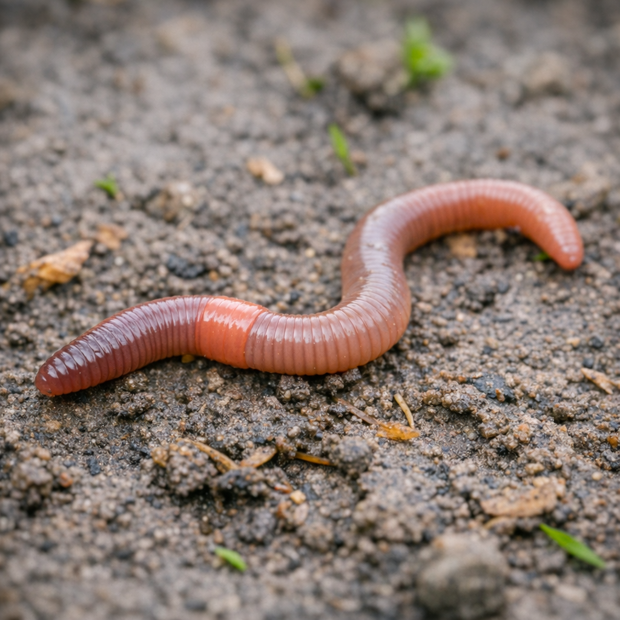
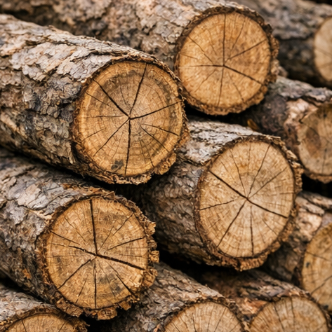

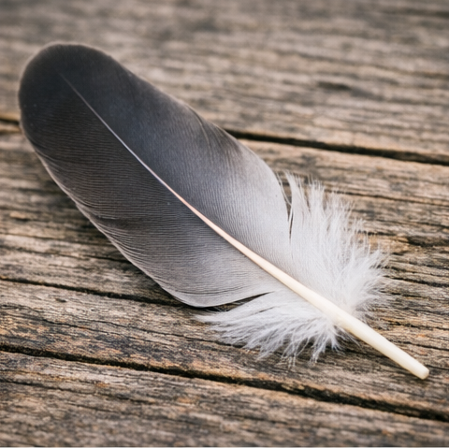
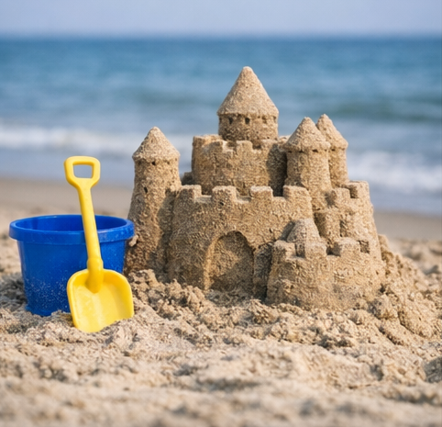
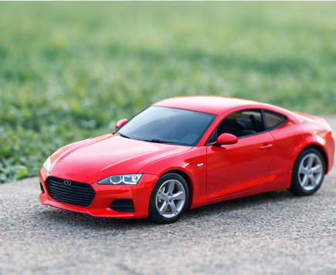
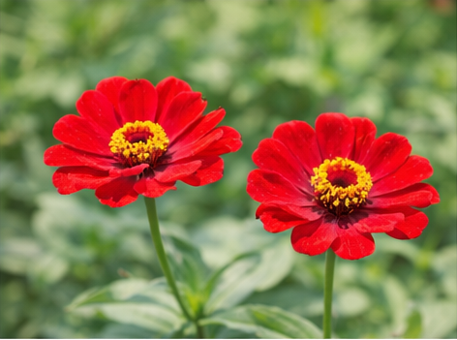
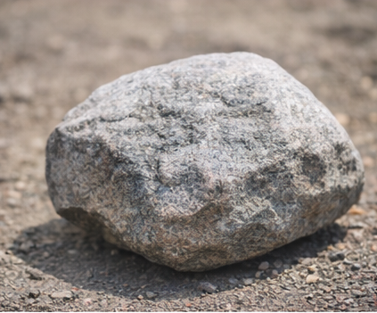
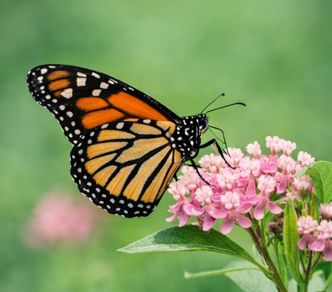
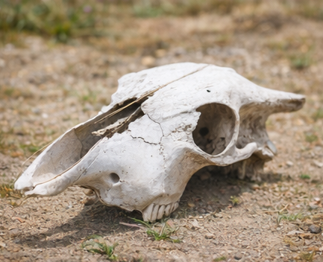
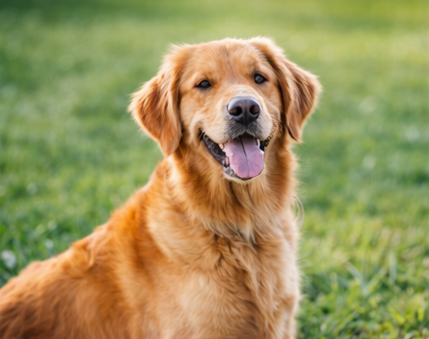
Click on the pictures to classify the images
Living
Non-living
Once-living

Slide 5
Living, non-living or once-living
Characteristics of
living things
Movement – they can move on their own, or parts of them move.
Respiration – they release energy from food.
Sensitivity – they respond to changes in their environment.
Growth – they become larger or more complex over time.
Reproduction – they can produce offspring.
Nutrition – they take in food or nutrients.
Excretion – they remove waste products.
Characteristics of
non‑living things
Do not move – any movement happens because something else moves them.
Do not breathe or respire – they do not use oxygen or release energy.
Do not respond to stimuli – they do not react to changes in the environment.
Do not grow – they stay the same size unless acted on by outside forces.
Do not reproduce – they cannot make more of themselves.
Do not excrete waste – they do not produce or remove waste products.
Do not need food or water – they do not take in nutrients.
May be man‑made or natural – e.g., plastic, metal, rocks, water.
Characteristics of
once‑living things
They used to be alive – they once showed the characteristics of life (such as growth, nutrition, and reproduction).
They no longer show life processes – they do not grow, breathe, move, or reproduce anymore.
They come from living organisms – they were part of a plant or animal.
They may still have organic material – such as wood, paper, leaves, feathers, wool, cotton, bones, or shells.
They can decay or decompose – because they contain once-living matter.

Slide 6
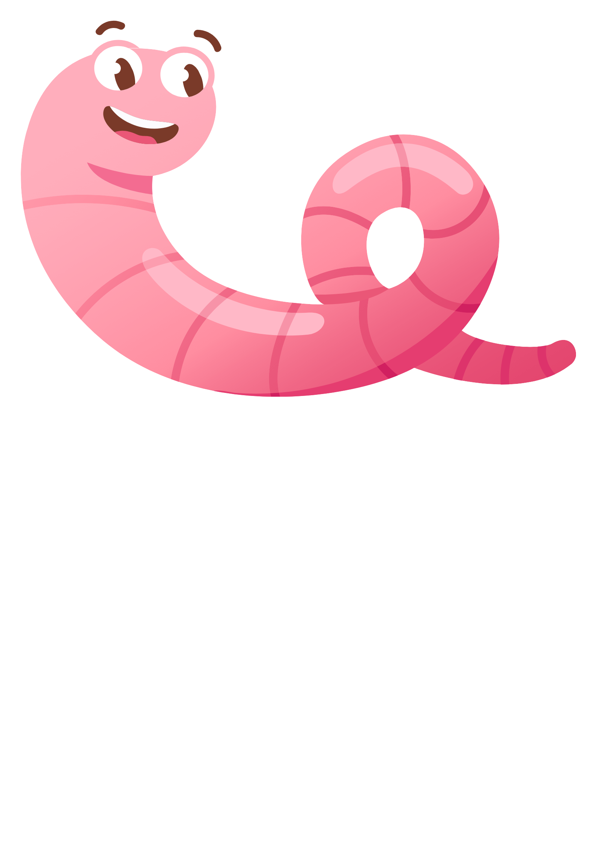
How we know
worms are living
Movement - Worms can move by contracting and expanding their muscles. Worms use bristles (called setae) to grip the soil.
Respiration - Worms breathe, even though they don’t have lungs. They absorb oxygen through their moist skin and release carbon dioxide.
Sensitivity - Worms respond to light, touch, moisture, and vibrations. They move away from bright light and dry conditions.
Growth - Worms grow larger over time as they feed and develop.
Reproduction - Worms reproduce by laying a cocoon that contains baby worms.
Nutrition - Worms eat organic matter such as dead plants and food scraps. They digest food and absorb nutrients to stay alive.
Excretion - Worms remove waste from their bodies in the form of castings (worm poo).

Slide 7
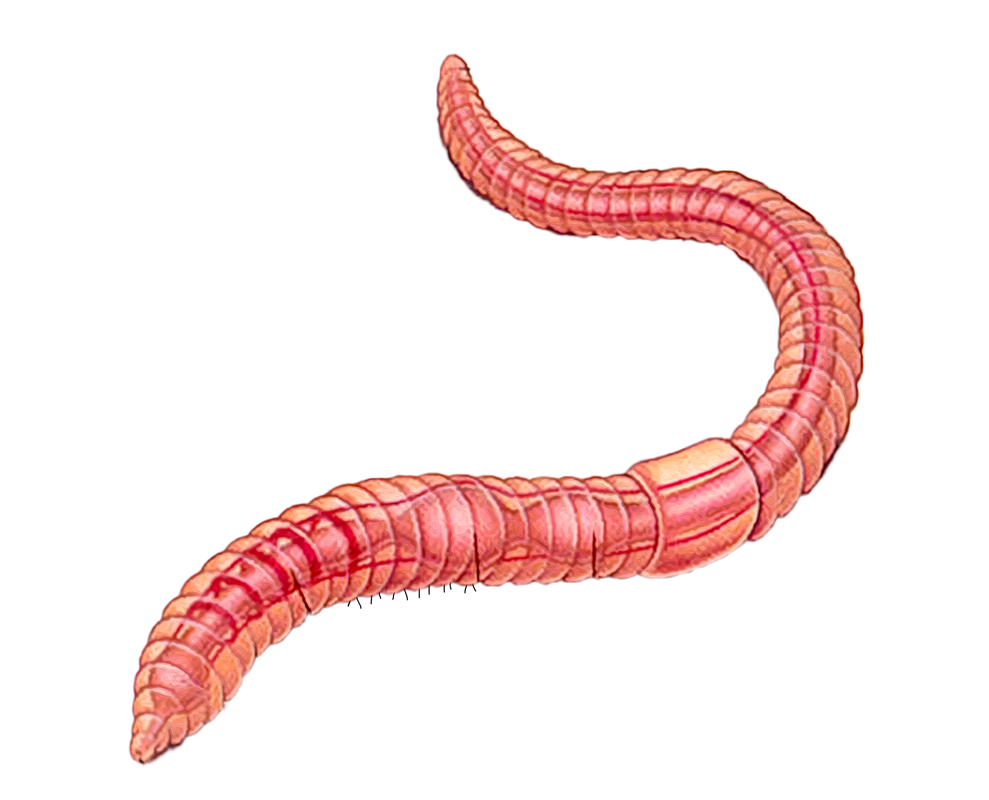
Anatomy of a worm
Click on the words to label the parts of the worm
mouth
clitellum
anus
segments
setae
(bristles)

Slide 8

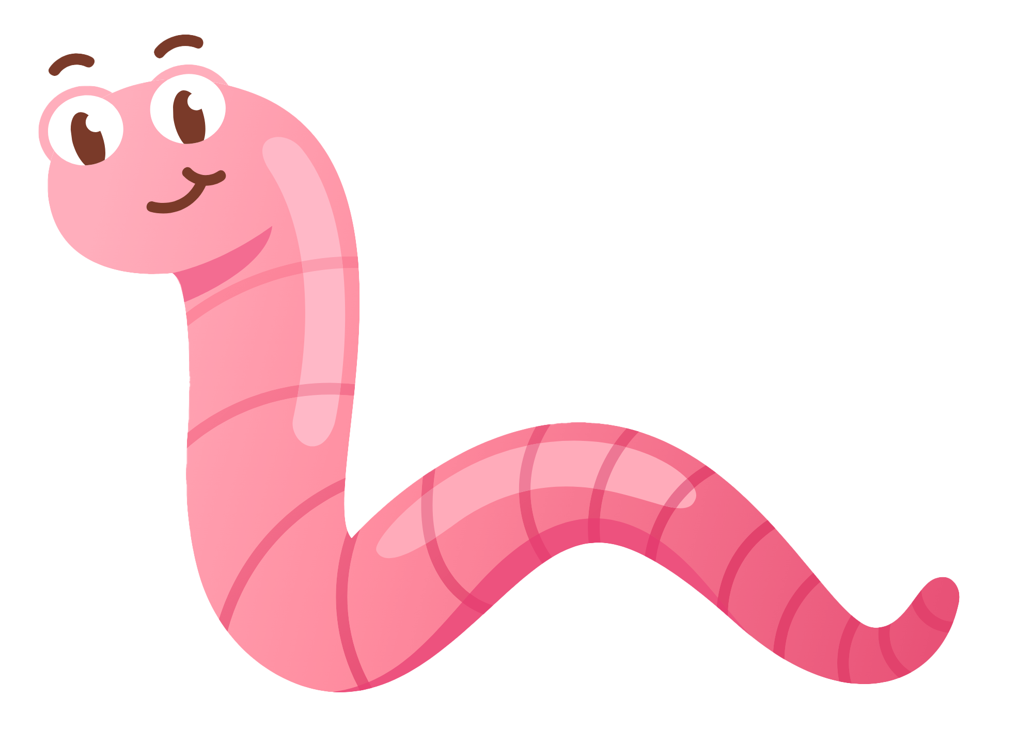
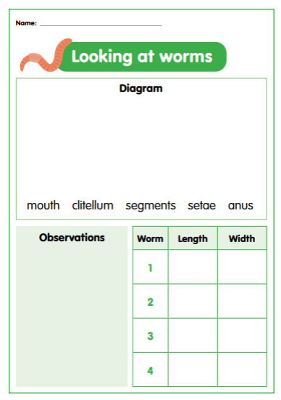
Let’s investigate
Remember, worms are living creatures. They need to be treated gently and touched as little as possible.
1. Observe your worms using a magnifying glass.
3. Record observations about the worm:
smell
colour
number of segments
can you find the worm’s head and tail?
does it have eyes, a nose, hair, or a mouth?
how does the worm’s skin feel?
do you think the worm has a skeleton?
how does the worm move?
does the worm have any special features? Describe them.
2. Complete a scientific drawing of your earthworm. Label the following parts on your diagram:
clitellum
anus
mouth
segments
bristles (setae)
4. Measure the length and weight of your worms. Record your measurements in a table.
Making it digital
Take a photo of a worm and use the text tool to add labels in the correct places.
Use a voice record function to record your observations about the worm.
Create a digital table to record measurements using an app of your choosing.

Slide 9
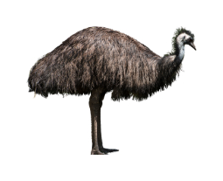
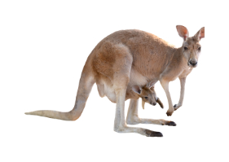
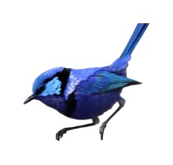
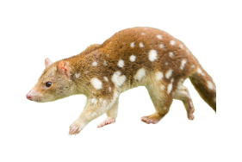
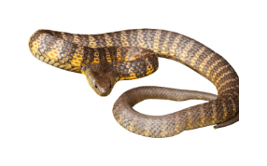
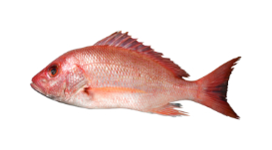
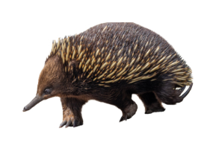
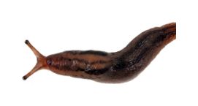
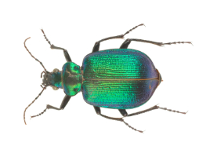
Classifying living things by observable characteristics
What are the similarities and differences between the characteristics of these animals and the characteristics of a worm. Consider things like number of legs, body covering, habitat, etc.

Slide 10
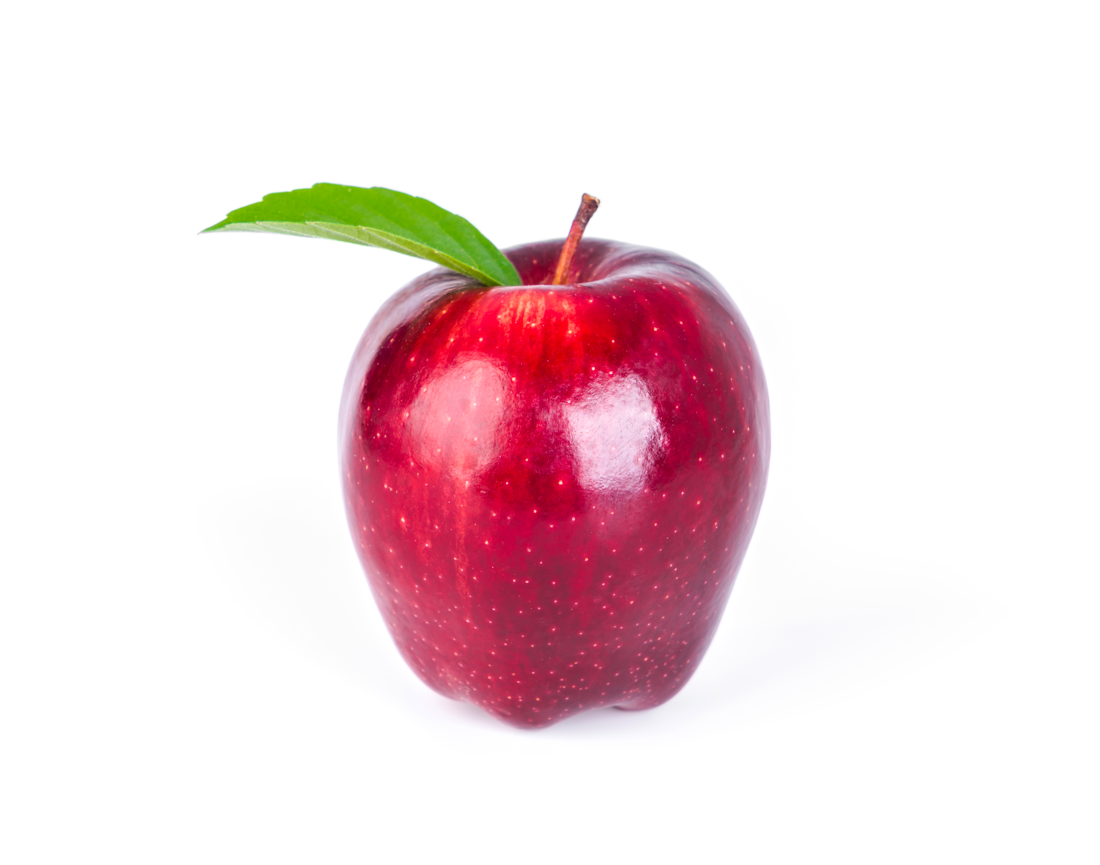
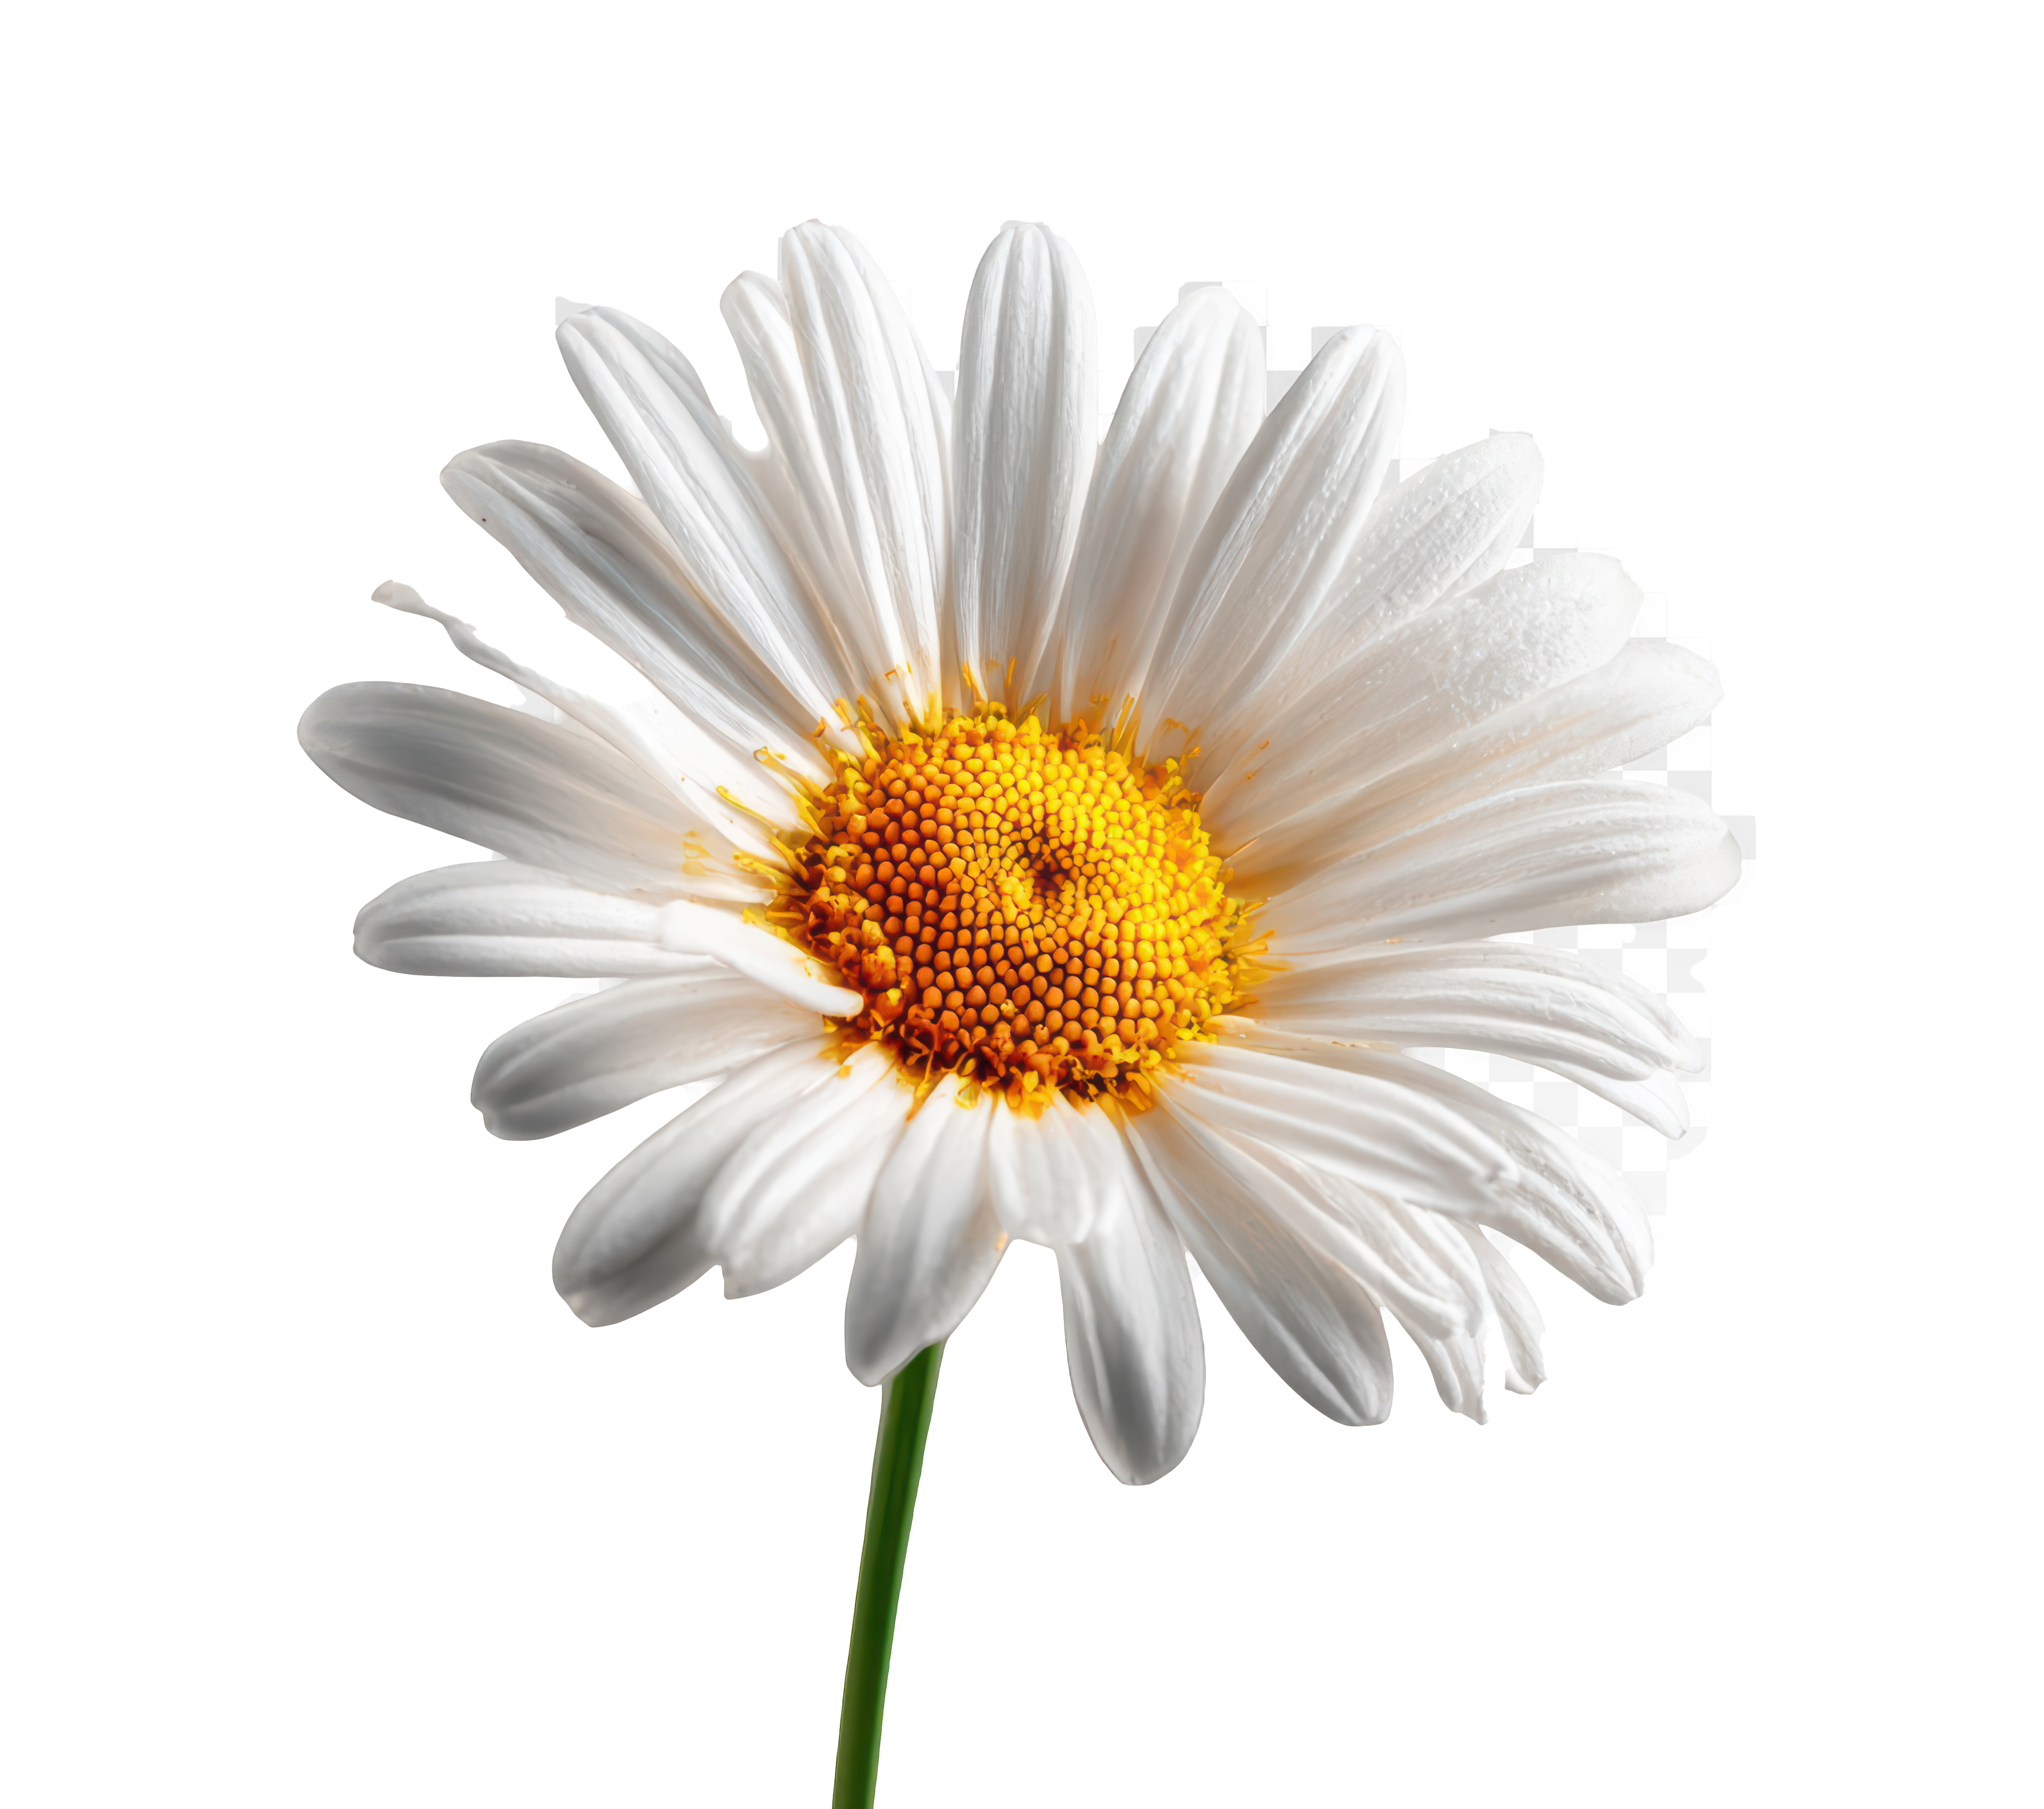
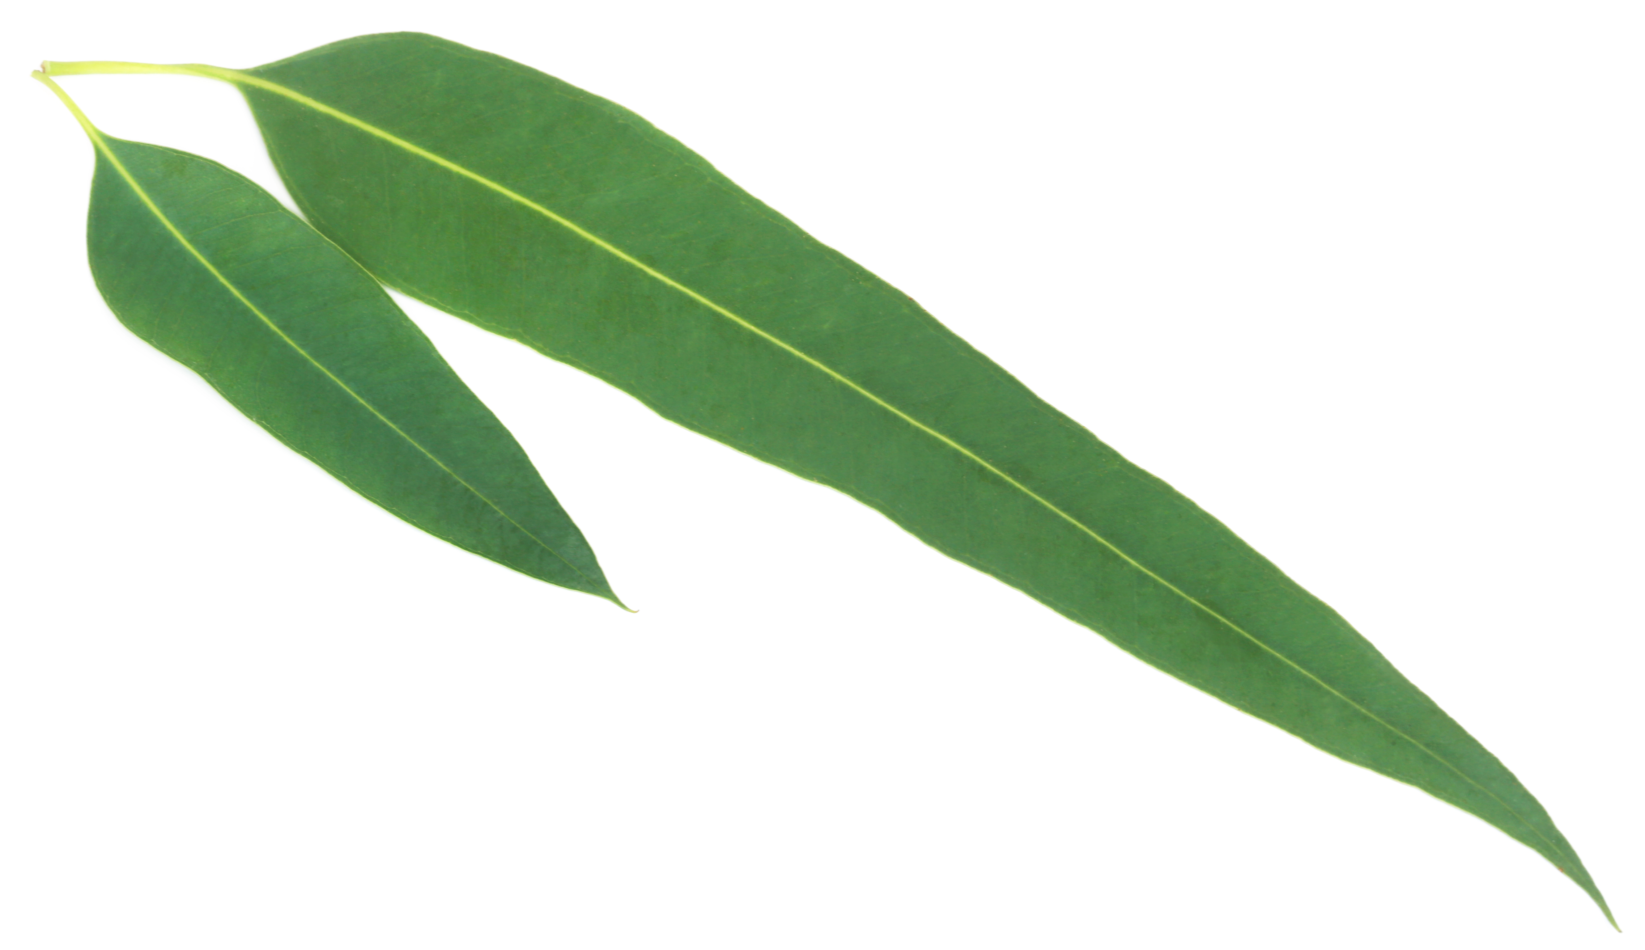
Producers, consumers, decomposers
Producers make their own food.
They use sunlight, water, and carbon dioxide to create energy through photosynthesis.
They form the base of every food chain because they provide the energy that all other organisms rely on.

Slide 11
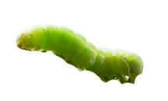
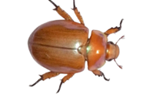
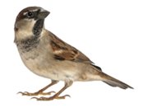
Producers, consumers, decomposers
Consumers cannot make their own food, so they must eat other organisms to get energy.
There are different types:
  Herbivores – eat plants
  Carnivores – eat other animals
  Omnivores – eat both plants and animals
Consumers depend directly or indirectly on producers for energy.

Slide 12
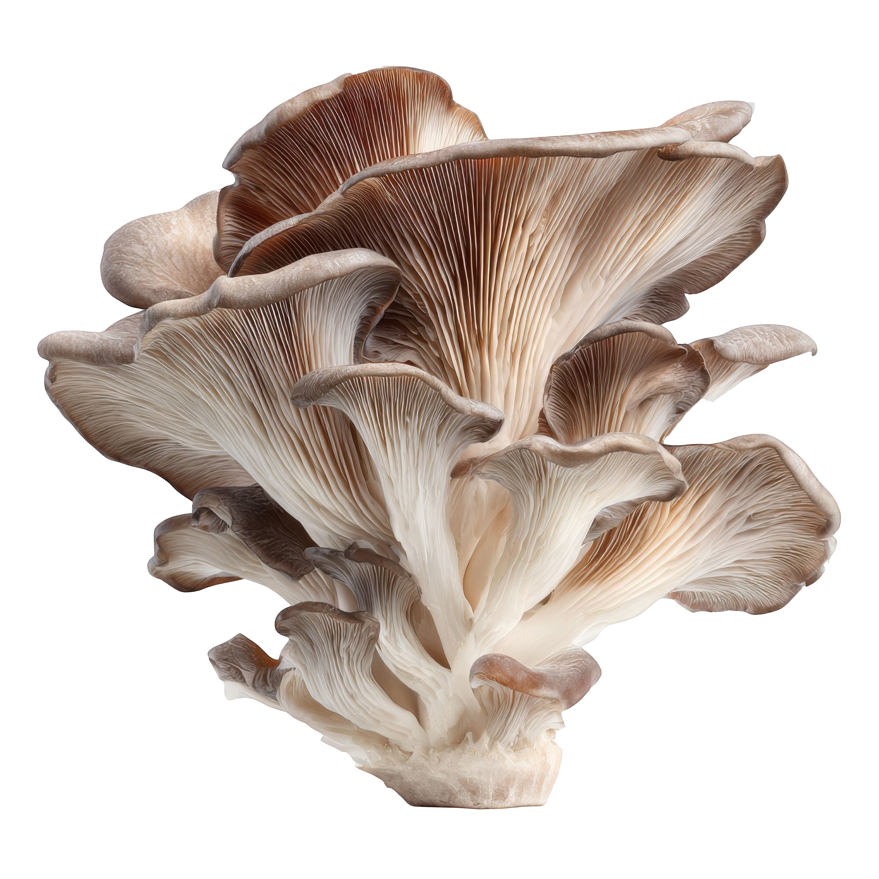
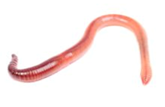
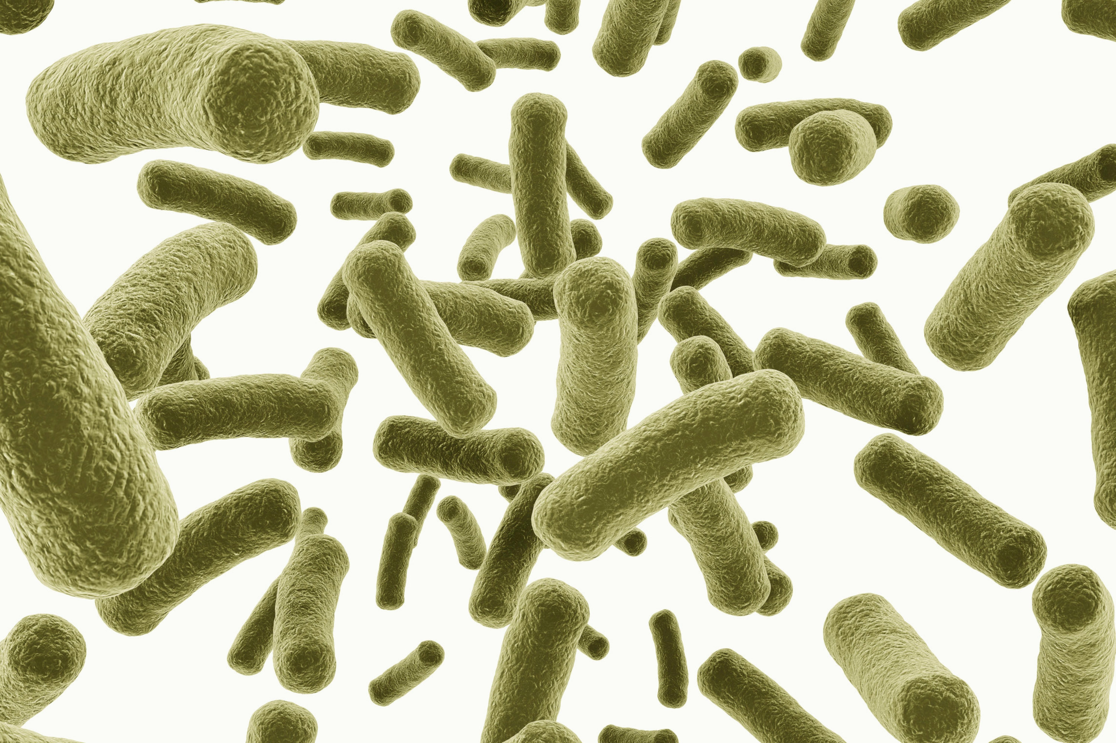
Producers, consumers, decomposers
Decomposers break down dead plants, animals, and waste into simpler substances.
This process returns nutrients to the soil so plants (producers) can use them again.
They recycle nutrients, keeping the ecosystem healthy and functioning.

Slide 13
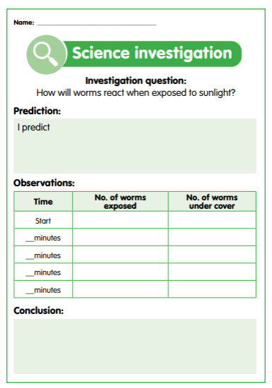
Let’s investigate
How will worms react when exposed to sunlight?
Cover half a tray with a thin layer of worm castings.
Place an exercise book (or piece of paper) over half of the tray to cover the castings.
Take the tray outside into sunlight (or place under lamp).
Gently place 10 worms on the side of the tray that is uncovered and give the worms some time to settle down.
Observe the worms for 15 to 20 minutes and record what happens.
Count and tally how many worms there are on each side of the tray every three to five minutes and record in a table.
After the experiment is finished, graph the results of your investigation (number of worms exposed or undercover versus time).
What conclusion can we draw about worms from this experiment?

Slide 14
Let’s investigate
1. Predict what you think will happen.
4. Analyse your findings to determine what the results show and how the worms responded.
2. Conduct the experiment following the method provided.
5. Draw a conclusion to the investigation question.
3. Record your results and observations.
6. Discuss your findings and conclusion.
Making it digital
Record experiment procedure and results using an app of your choosing.
Take a photo or video of worms to show how they respond to the light.
Use a voice record function to record your observations and conclusions.

Slide 15

Let’s discuss
How did your results compare with your prediction?
How did the worms respond to light?
Why do you think the worms responded the way they did?
Did everyone get the same results?
Was this experiment fair and accurate?
How could you improve this experiment?

Slide 16
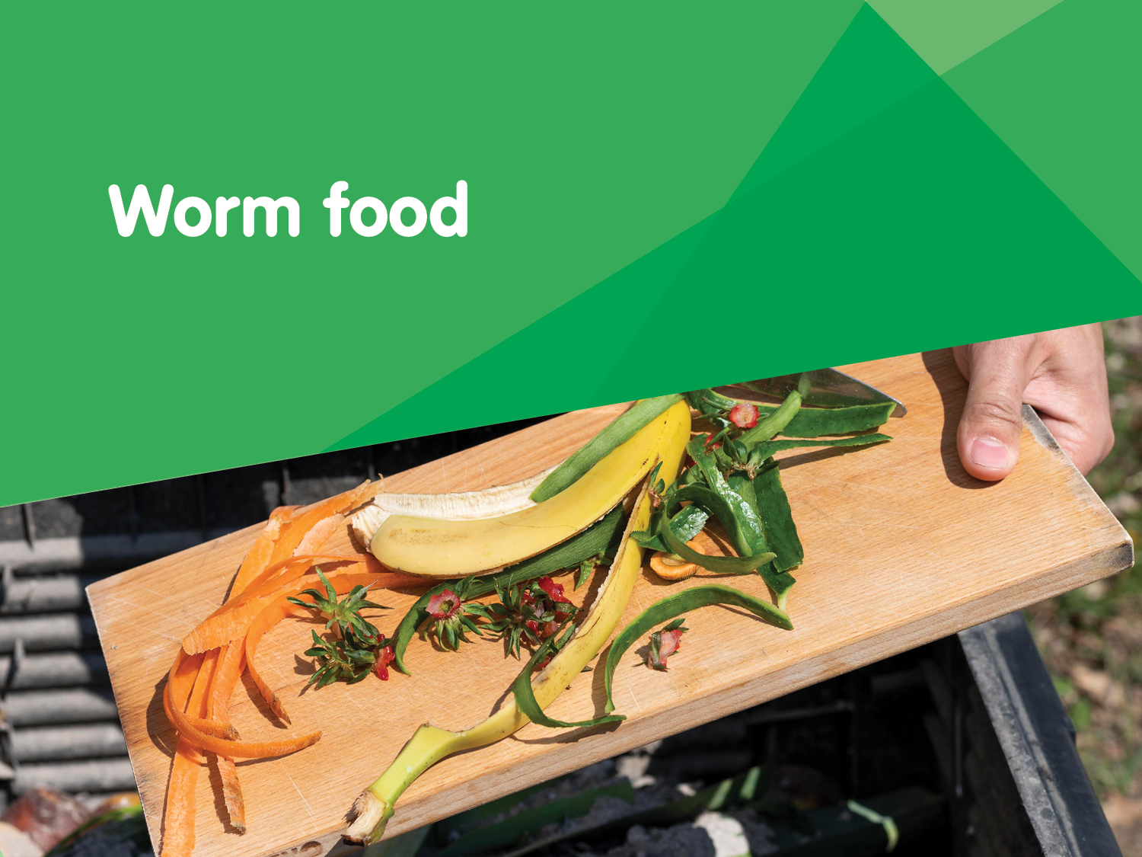

Slide 17
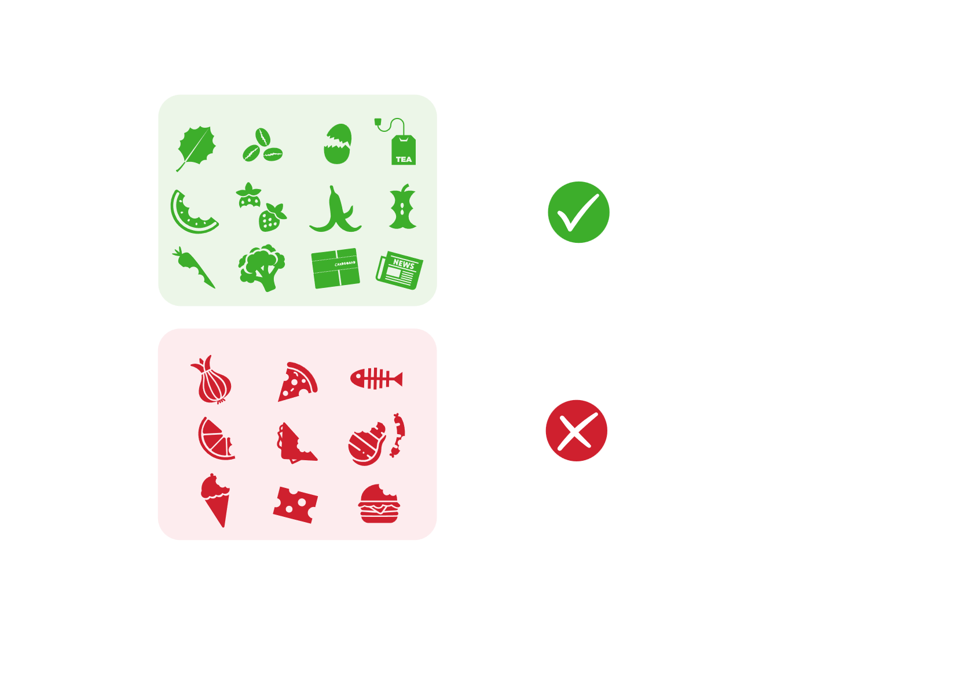
What do worms like to eat?
Composting worms can process anything organic.
They enjoy eating fruit and vegetable scraps, eggshells, tea and coffee grounds as well as shredded newspaper, straw or dry leaves.
Things to avoid in your worm farm:
  meat products
  dairy products
  white office paper
  bread
  citrus
  onions

Slide 18
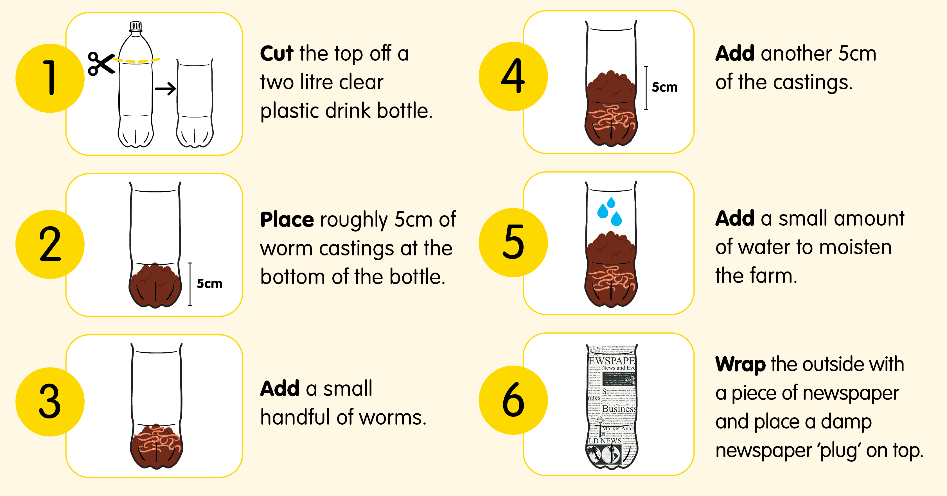
How to make a mini worm farm

Slide 19

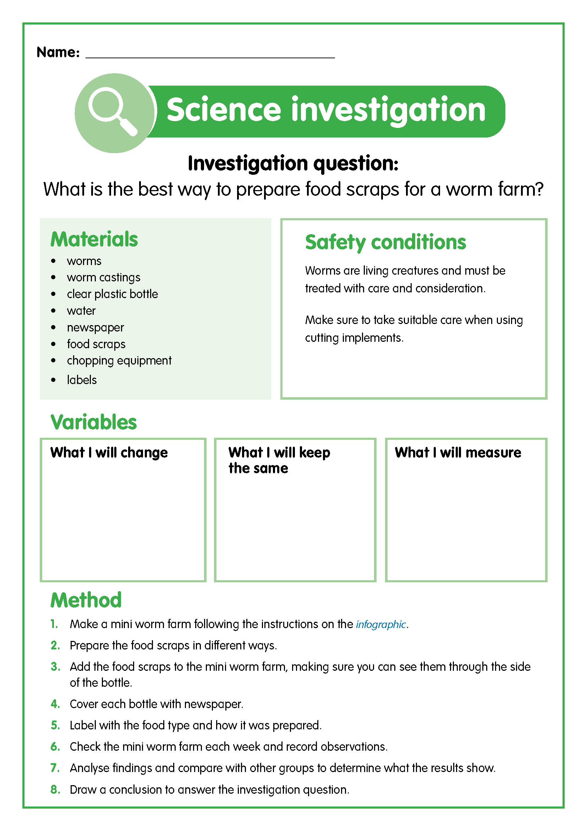
Let’s plan
You are going to design an experiment that will allow you to investigate how food should be prepared to optimise the amount of scraps that can be composted in a worm farm.
What will I change?
Think about the different types of food available and how they could be prepared?
Let’s predict what we think will happen?
What will I keep the same?
Think about the things that should be kept the same to make the experiment fair.
What will I measure?
What will you be able to observe and record?

Slide 20
Let’s investigate
1. Make your mini worm farm using the steps outlined in the infographic.
3. Add the prepared food to your mini worm farm. Make sure that you can see the food through the side of the bottle and that the food is completely covered with castings.
4. Cover and label your worm farm.
2. Prepare
your food scraps as per your experiment design.
5. Predict what you think will happen.
6. Check the worm farms every few days.

Slide 21

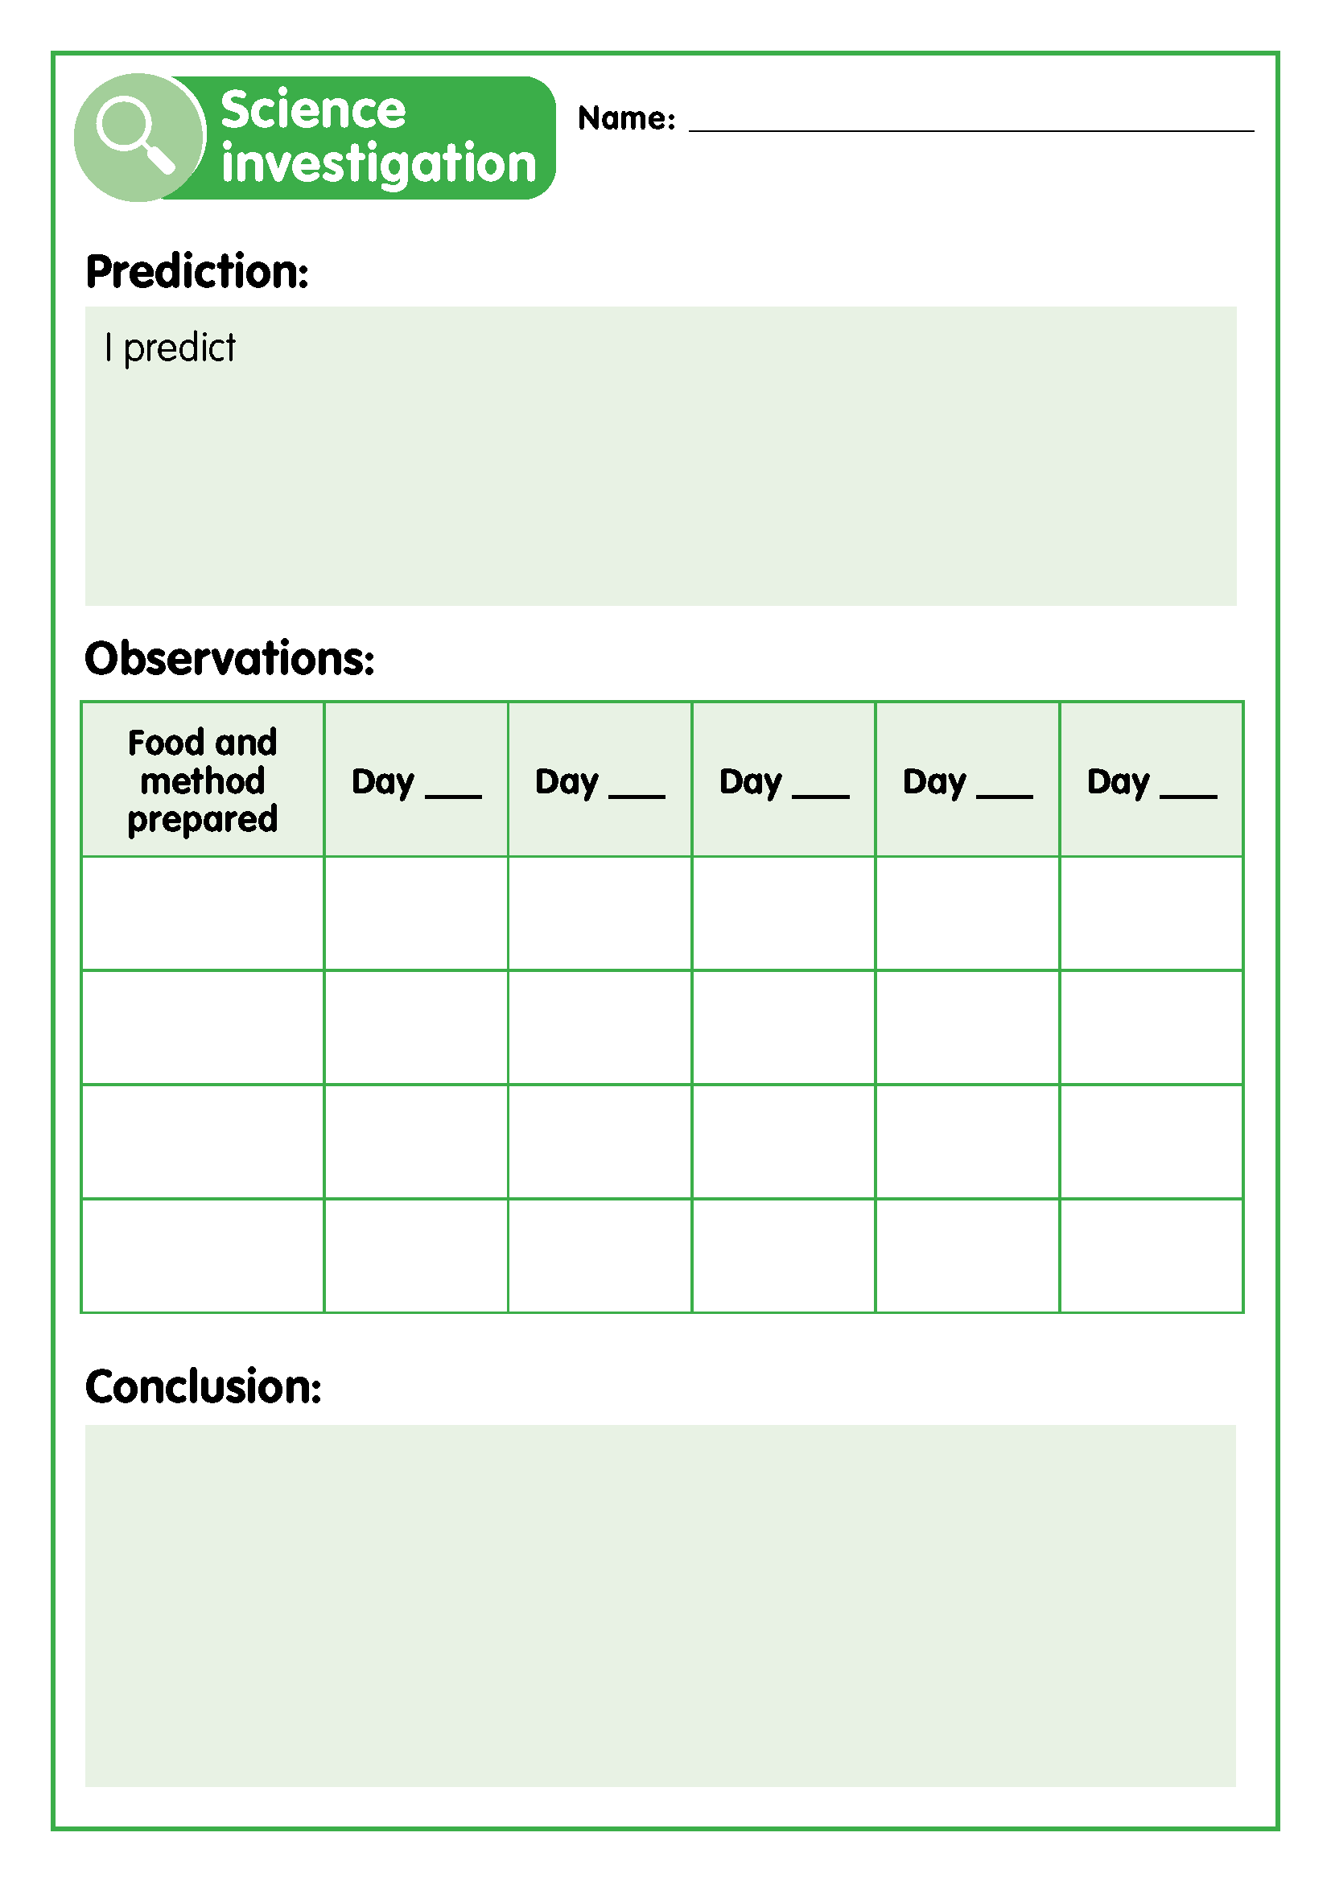
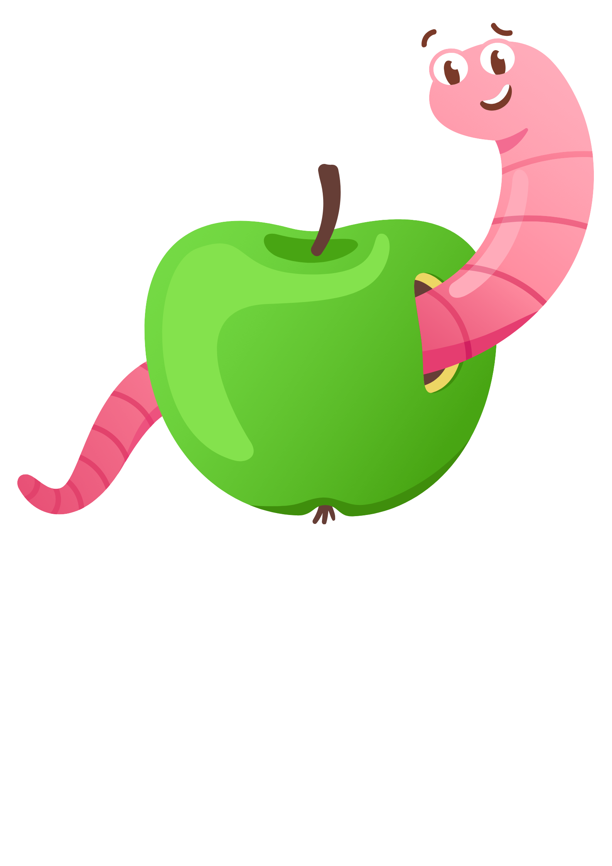
Let’s record
Record your observations until all the food scraps have been turned into castings.
Analyse your findings and compare with other groups to determine what the results show.
Draw a conclusion to answer your investigation question.
Discuss your findings and conclusion.
Making it digital
Use a digital device to take photos of the food in the worm farm each week.
Import the photos into an app of your choosing and label them with the date they were taken to create a visual timeline of the food being turned into castings.

Slide 22
Let’s discuss
Which food preparation style was eaten the quickest?
Which food preparation style was eaten the slowest?
Did your findings match your predictions? Why/why not?
Can you think of a reason that your findings did not match your predictions?
Was your experiment design fair? Why/why not?
Did you notice any patterns when you compared your data with other groups?
Why is a worm farm a suitable place for worms to live?

Slide 23
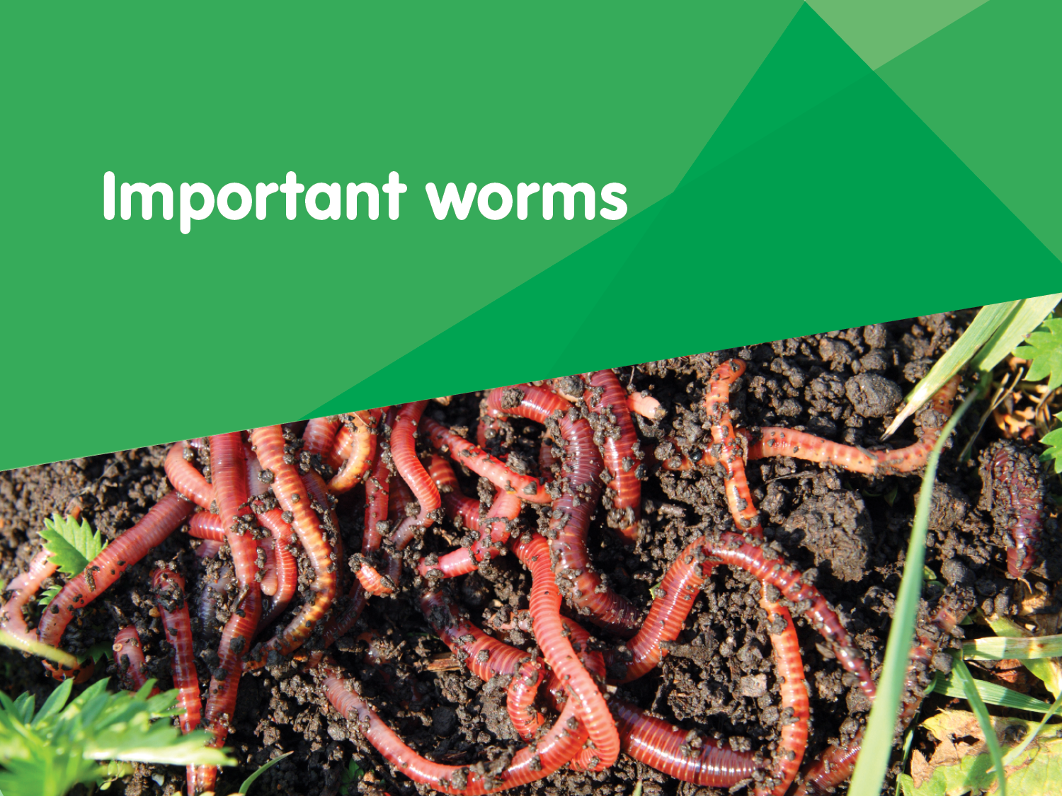

Slide 24
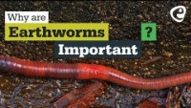
Let’s discuss
Let’s watch the video to find out why worms are so important.
Discussion questions
How big can some species of worm grow?
How many different species of worms are there worldwide?
How many groups of worm species are there?
What do worms eat?
How many times more nutrients does soil that has passed through a worm have?
Why is it good when worms break soil apart?
Why are earthworms important? - YouTube

Slide 25
Why worms are important
Worms make tunnels when they move through the soil. These tunnels make it easier for plant roots to absorb the oxygen and water they need to grow.
Worm waste provides food for plants. Worm poo is called castings and worm wee is called leachate. These both add nutrients to the soil.
Worms eat lots of organic waste, things like old plants, fallen leaves and food scraps.
They improve and build soil by improving its physical structure, enriching it with micro-organisms and improving water-holding capacity.
They increase crop yield by helping with germination, improving root growth and structure, and feeding growing plants.

Slide 26
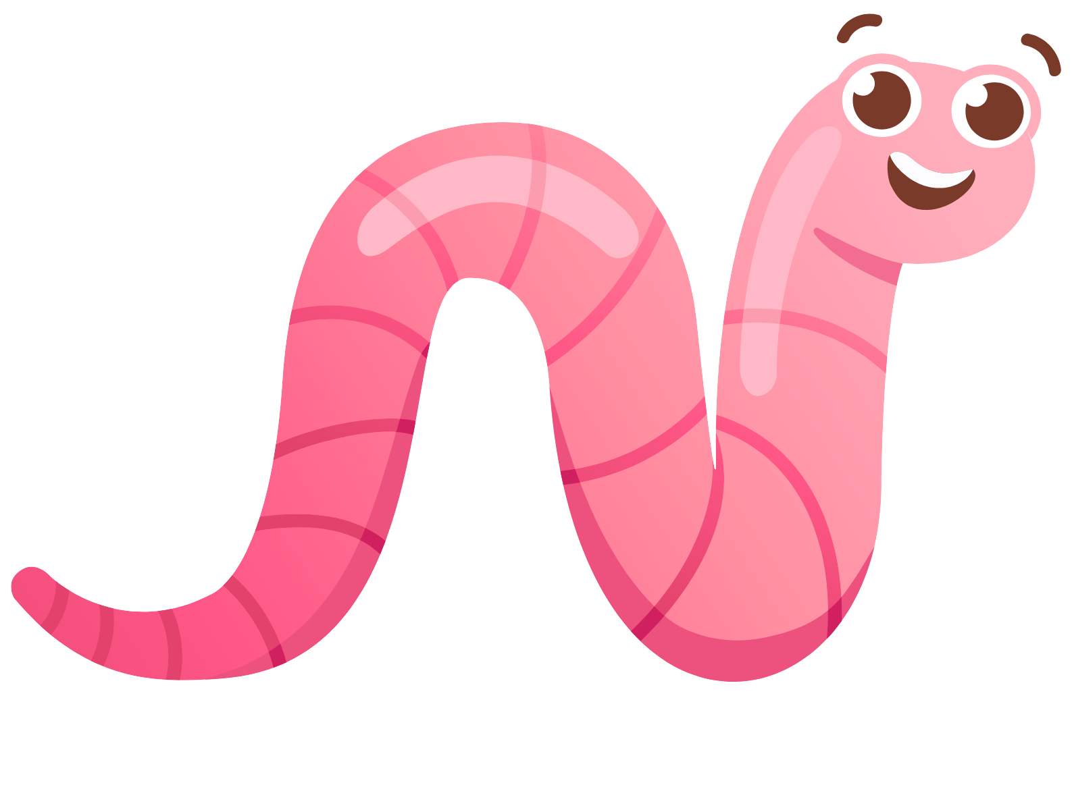
Why worm farms are important
Worm farms decrease the amount of organic waste that is sent to landfill.
They close the recycling loop. Our organic waste is changed into organic fertiliser that plants use and produce food for us to eat.

Slide 27
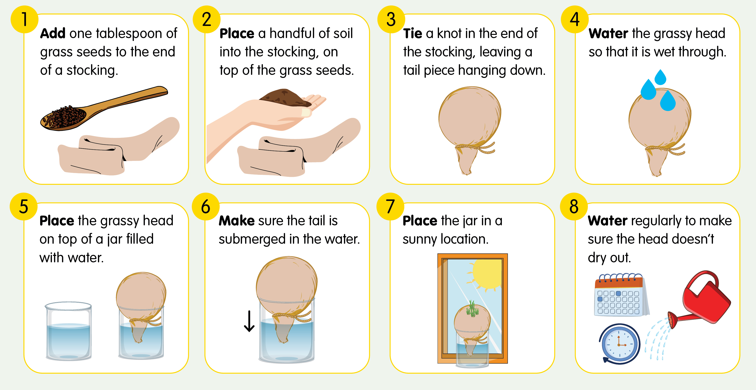
How to make a grassy head

Slide 28


Let’s plan
You are going to conduct an experiment that will allow you to investigate the impact of worm castings and leachate on plant growth.
Which questions are relevant to our experiment and can be investigated scientifically?
What are the variables in this experiment?
Plain soil
50/50 mixture of plain soil and worm castings
Water
Leachate
What is the effect of worm leachate on growing grass?
Do worms eat grass?
Do worm castings help plants to grow?
Can people eat worms?
Do plants grow better when fed worm waste?
How will we ensure our variables are kept consistent to get a fair result?

Slide 29
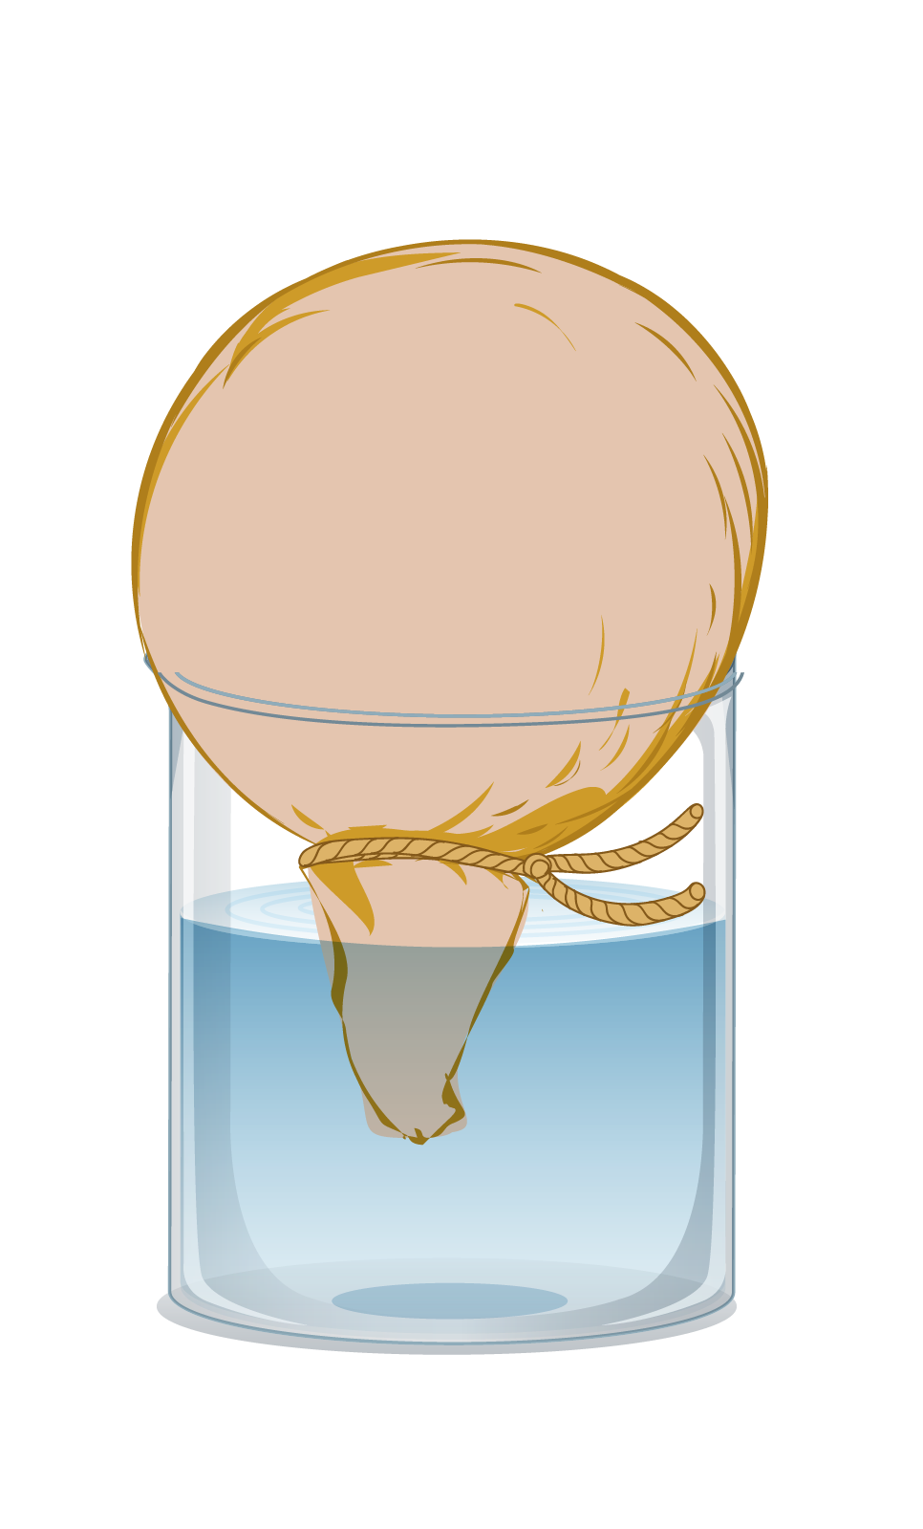
Let’s investigate
1. Make your grassy heads following the instructions on the infographic.
4. The beneficial microbes in worm leachate can be harmed by light, so wrap the jar with newspaper if using.
2. Keep your constants and variables consistent to ensure accurate results.
5. Check the grassy heads regularly and record your observations.
3. Clearly label each head with the variables being tested.
Consider:
What is the most effective way to collect data from this investigation?
What results can we measure?
How often should we measure?
Let’s predict what we think will happen?

Slide 30
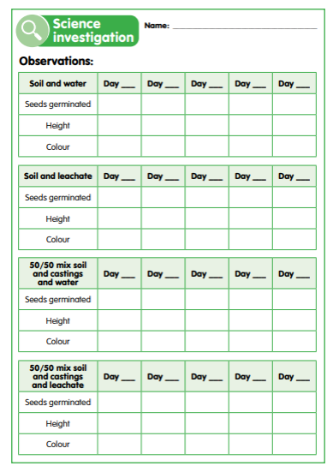

Let’s record
Record the height and colour of the grass at regular intervals as it grows.
Draw a conclusion to answer your investigation question.
Graph your results.
Discuss your findings and conclusion.
Analyse your findings and compare with other groups to determine what the results show.
Making it digital
Use a digital device to take photos of the changes to the grassy heads and use these to create a visual record of any changes.
Record your measurements and observations digitally through text, audio or video.
Combine these elements to complete a digital scientific report.

Slide 31
Let’s discuss
Which stocking head grew ‘hair’ the fastest?
Why do you think this is?
Did your findings match your predictions? Why/why not?
What does this tell us about the effect of worm leachate and castings on plants?
Do you think this was a fair experiment to test the effect of worm leachate and castings on plant growth?
Why are worms beneficial to have in a garden?
What could we do with worm leachate and castings at school?
If you had your own garden, would you use worm leachate or castings on it? Why?

